Slide 1
Mini-Test 1 Revision
Miss L
Year 8

Slide 2
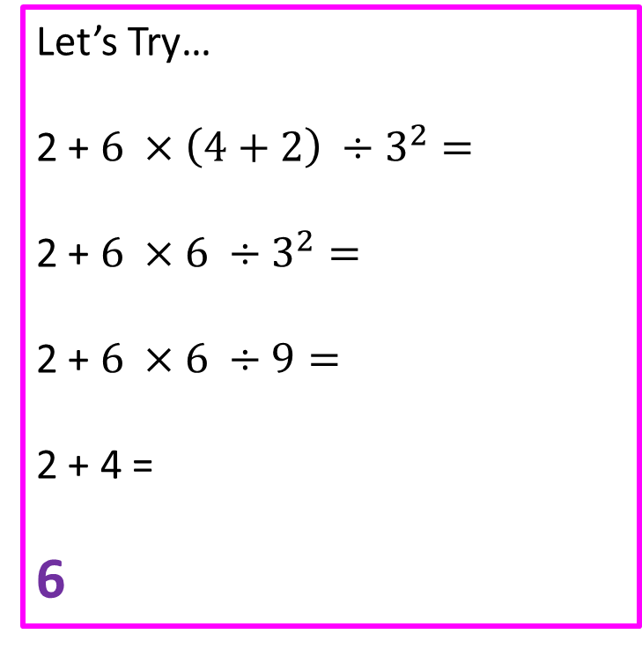
24
7
30
Mini-Test 1 Revision
Date
EQ – What have we learnt so far?
Order of Operations / BIMDAS
1. Brackets First
2. Indices
3. Multiply and/or Divide
(from left to right)
4. Add or Subtract
(from left to right)
Let’s Try…
2 + $6 ×\left(4+2\right) ÷3^{2}=$
2 + $6 ×6 ÷3^{2}=$
2 + $6 ×6 ÷9=$
2 + 4 =
6
What are the rules of BIMDAS?

Slide 3
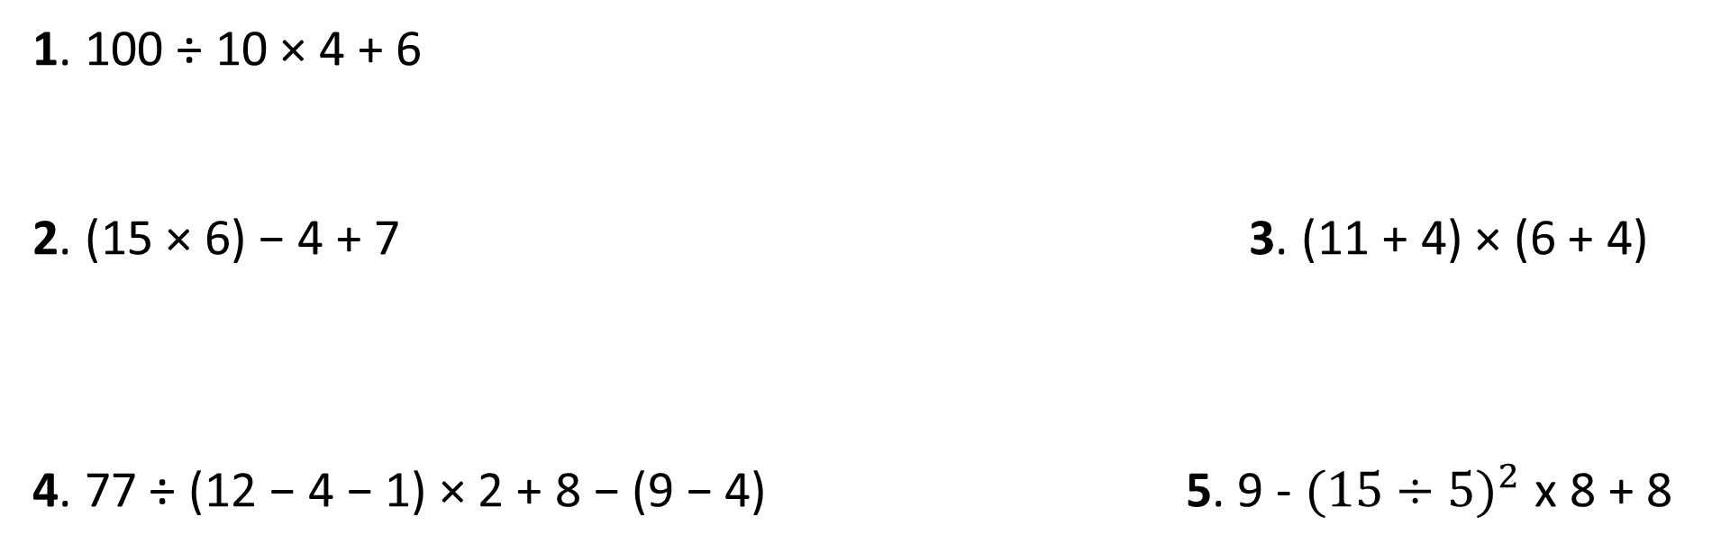
Practice
1. 100 ÷ 10 × 4 + 6
2. (15 × 6) − 4 + 7 3. (11 + 4) × (6 + 4)
4. 77 ÷ (12 − 4 − 1) × 2 + 8 − (9 − 4) 5. 9 - ${(15÷5)}^{2}$ x 8 + 8

Slide 4


Slide 5


24
7
30
Mini-Test 1 Revision
Date
EQ – What have we learnt so far?
Subtraction
Addition
Adding and Subtracting Integers
Subtraction we go left!
Addition we go right!

Slide 6

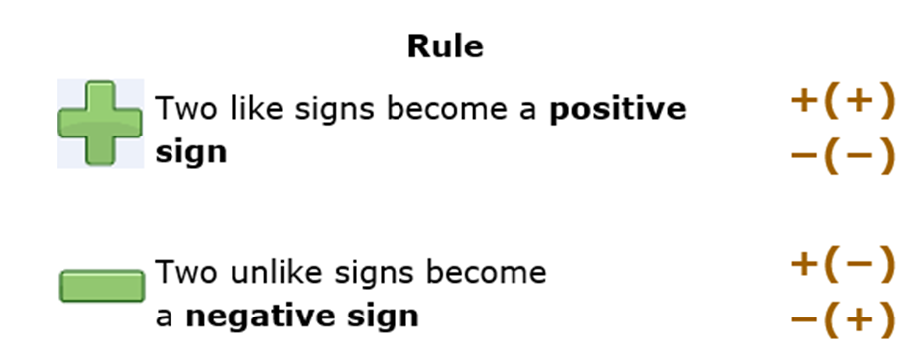
24
7
30
Mini-Test 1 Revision
Date
EQ – What have we learnt so far?
Adding and Subtracting Integers

Slide 7
Practice
-2 - 7 =
2 + 3 =
8 - 3 =
3 + -9 =
4 – (-9) =
-6 + (-5) =

Slide 8
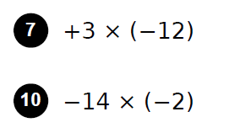
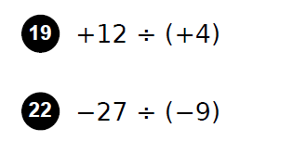
Practice

Slide 10

24
7
30
Mini-Test 1 Revision
Date
EQ – What have we learnt so far?
Index Notation
Index
Base
Extended or expanded form

Slide 11
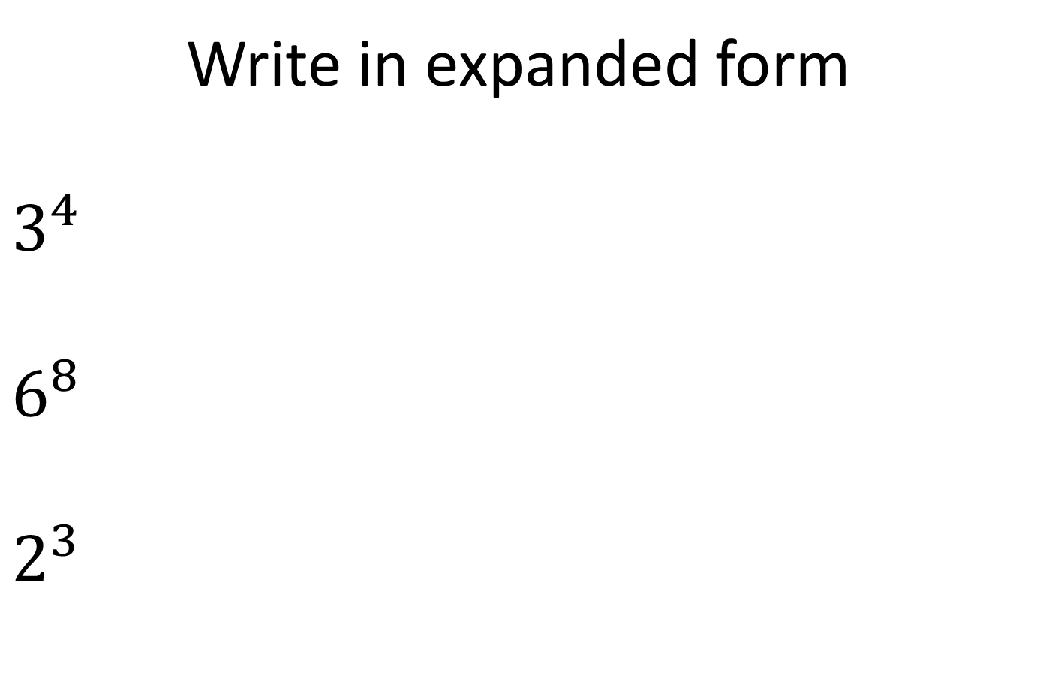
Practice
Write in expanded form
$3^{4}$
$6^{8}$
$2^{3}$

Slide 12
Practice
Write in index notation form
3 x 3 x 3 x 3 =
4 x 4 x 4 x 5 x 5 x 5 x 5 x 5 =
N x N x N x Y x Y x H x H =

Slide 13

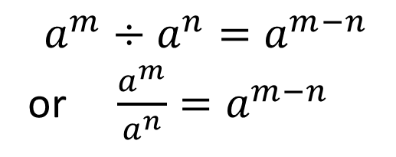
24
7
30
Mini-Test 1 Revision
Date
EQ – What have we learnt so far?
Index Law 1
Index Law 2

Slide 14
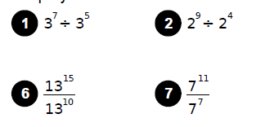
Task

Slide 15

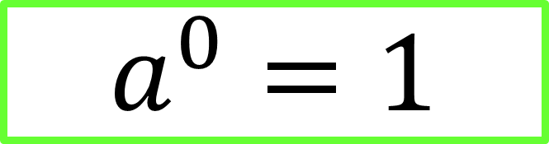
24
7
30
Mini-Test 1 Revision
Date
EQ – What have we learnt so far?
$$(a^{m})^{n}=a^{m×n}$$
Index Law 3
Index Law 4
$$a^{0}=1$$

Slide 16
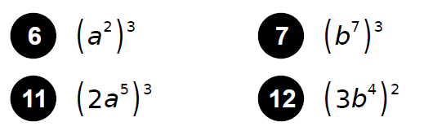
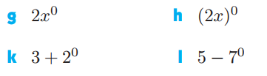
Task

Slide 17
Task
Make a notes page
Only 1 side of a A4 page
Note: calculators will not be allowed during the test

